Slide 1
Multiversioning
Seminar 4

Slide 2
Monitoring locks
SQL Server Profiler
Is a graphical user interface to SQL Trace for monitoring an instance of the Database Engine or Analysis Services
Events are saved in a trace file that can later be analyzed or used to replay a specific series of steps when trying to diagnose a problem
sp_lock
Reports information about locks
sys.dm_tran_locks
Returns information about currently active lock manager resources
Each row represents a currently active request to the lock manager for a lock that has been granted or is waiting to be granted

Slide 3
Monitoring locks
sys.dm_tran_active_transactions
Returns information about transactions for the instance of SQL Server
Resource types:
RID – row identifier
Key – range of keys in an index (key-range locks)
Page – 8 KB page from tables/indexes
HoBT – Heap or balanced tree
Table, File, Database
Metadata
Application

Slide 4
Query Governor
SET QUERY_GOVERNOR_COST_LIMIT
Overrides the currently configured query governor cost limit value for the current connection
Query optimizer estimates the number of seconds needed to run a query and if it is bigger than setting, the query will not run
The default value is 0 (this value allows all queries to run)

Slide 5
DBCC LOG
Returns information about transactions log
Syntax:
DBCC LOG (<databasename>,<output id>)
<output id> is a value between 0 and 4 (specifies the level of detail)
<databasename> is the name of the database

Slide 6
Isolation Levels in SQL Server
READ UNCOMMITTED
No lock when reading
READ COMMITTED (SQL Server default)
Holds locks during statement execution
Solves Dirty reads concurrency problem
REPEATABLE READ
Holds locks for the duration of transaction
Solves Unrepeatable reads concurrency problem (and all the other concurrency problems solved by lower isolation levels)

Slide 7
Isolation Levels in SQL Server
SERIALIZABLE
Holds locks and key range locks during entire transaction
Solves Phantom reads concurrency problem (and all the other concurrency problems solved by lower isolation levels)
SNAPSHOT
Works on data snapshot
SQL syntax:
SET TRANSACTION ISOLATION LEVEL { READ UNCOMMITTED | READ COMMITTED | REPEATABLE READ | SNAPSHOT | SERIALIZABLE }

Slide 8
Multiversioning
In a multiversion DBMS, each write on a data item x produces a new copy (or version) of x
For each read on x, the DBMS selects one of the versions of x to be read
Since writes do not overwrite each other, and since reads can read any version, the DBMS has more flexibility in controlling the order of reads and writes

Slide 9
Row-Level Versioning (RLV)
Introduced in SQL Server 2005
Useful when committed data is needed, but not mandatory the most recent version
Read Committed Snapshot Isolation and Full Snapshot Isolation
The reader never blocks
The reader gets the previously committed value
All older versions are stored in tempdb database
A snapshot of database could be constructed by old versions

Slide 10
Read Committed Snapshot Isolation
All operations see committed records when SQL command execution started =>
Snapshot of data at command level
Consistent read at command level
Available if READ COMMITED isolation level is used (default) and READ_COMMITTED_SNAPSHOT option set to ON
How to set READ_COMMITTED_SNAPSHOT ON:
ALTER DATABASE database_name
SET READ_COMMITTED_SNAPSHOT ON;

Slide 11
Full Snapshot Isolation
All operations see committed records when transaction execution started =>
Snapshot of data at transaction level
Consistent read at transaction level
SNAPHOT isolation level could be used
Available if ALLOW_SNAPSHOT_ISOLATION option is set to ON
How to set ALLOW_SNAPSHOT_ISOLATION ON:
ALTER DATABASE database_name
SET ALLOW_SNAPSHOT_ISOLATION ON;

Slide 12
Row-Level Versioning
One record contains TSN (transaction sequence number)
All versions are stored in a linked list
Current Row (col1 = 1, col2 = 11)
Created by transaction T3
Previous Version Row (col1 = 1, col2 = 9)
Created by transaction T2
Previous Version Row (col1 = 1, col2 = 5)
Created by transaction T1

Slide 13
Row-Level Versioning
Advantages
The level of concurrency is increased
Affects the performance of triggers/index creation
Drawbacks
Extra management requirements to monitor the usage of tempdb
Slower performance of update operations
Readers speed is affected by the cost of browsing the linked lists
Solves the conflict between writer and readers but simultaneous writers are still not allowed

Slide 14
Triggers and Row-Level Versioning
Triggers have access to two pseudo-tables:
‘deleted’ table – contains deleted rows or old versions of updated rows
‘inserted’ table – contains inserted rows or new versions of updated rows
Before SQL Server 2005
‘deleted’ table created based on transaction logs – affects performance
Using Row-Level Versioning
For tables with relevant triggers the changes are versioned

Slide 15
Index Creation and Row-Level Versioning
In previous versions of MS SQL Server, index creation or rebuilding meant:
Table exclusively locked, data completely inaccessible (clustered indexing)
Table shared for reading only and index not available (non-clustered indexing)
With Row-Level Versioning:
Indexes are created and rebuilt online
All requests will be processed on versioned data

Slide 16
Isolation Levels and Concurrency Anomalies
Isolation Level | Dirty Reads | Non-repeatable Reads | Phantom Reads | Update conflict | Concurrency Model
Read Uncommitted | Yes | Yes | Yes | No | Pessimistic
Read Committed Locking | No | Yes | Yes | No | Pessimistic
Read Committed Snapshot | No | Yes | Yes | No | Optimistic
Repeatable Read | No | No | Yes | No | Pessimistic
Row-Level versioning | No | No | No | Yes | Optimistic
Serializable | No | No | No | No | Pessimistic

Slide 17
OUTPUT clause
The OUTPUT clause provides access to updated, inserted and deleted records and it can implement some functionalities that are generally performed only by triggers
Table ‘Persons’
Table ‘ModifiedPersonNames’
p_id | name | city
3 | Jane Brown | London
5 | Joe Brown | New York
m_id | p_id | old_name | new_name | update_time | update_user

Slide 18
OUTPUT clause
The following operation updates the name of the person that has p_id=5 from table ‘Persons’ and stores in the table ‘ModifiedPersonNames’ the p_id value, the old name value (deleted.name), the new name value (inserted.name), the current date (GETDATE()) and the login name (SUSER_SNAME()):
UPDATE Persons SET name = 'Joe Black' OUTPUT inserted.p_id, deleted.name, inserted.name, GETDATE(), SUSER_SNAME() INTO ModifiedPersonNames WHERE p_id = 5;

Slide 19
OUTPUT clause
The result:
Table ‘Persons’
Table ‘ModifiedPersonNames’
p_id | name | city
3 | Jane Brown | London
5 | Joe Black | New York
m_id | p_id | old_name | new_name | update_time | update_user
1 | 5 | Joe Brown | Joe Black | 2018-04-17 13:58:56.090 | ACER\userpc

Slide 20
MERGE statement
The MERGE statement performs insert, update or delete operations on a target table based on the results of a join with a source table
Two tables can be synchronized by inserting, updating or deleting rows in one table based on differences found in the other table
Movies table:
Movie_id | Title | Year | Runtime
1 | IT | 2017 | NULL
2 | IT | NULL | NULL
3 | IT | NULL | 135

Slide 21
MERGE statement
Syntax:
MERGE Table definition AS Target
Using (Table Source) AS Source
(Column Keys)
ON (Search Terms)
WHEN MATCHED THEN
UPDATE SET
or
DELETE
WHEN NOT MATCHED BY TARGET/SOURCE THEN
INSERT

Slide 22
MERGE statement
Example:
MERGE Movies
USING (SELECT MAX(Movie_id) Movie_id, Title, MAX(Year) Year, MAX(Runtime) Runtime FROM Movies GROUP BY Title) MergeMovies ON Movies.Movie_id = MergeMovies.Movie_id
WHEN MATCHED THEN
UPDATE SET Movies.Title = MergeMovies.Title, Movies.Year = MergeMovies.Year, Movies.Runtime = MergeMovies.Runtime
WHEN NOT MATCHED BY SOURCE THEN DELETE;

Slide 23
MERGE statement
The result:
Movie_id | Title | Year | Runtime
3 | IT | 2017 | 135

Slide 24
PIVOT / UNPIVOT
Changes a table-valued expression into another table
PIVOT rotates a table-valued expression by turning the unique values from one column in the expression into multiple columns in the output, and performs aggregations where they are required on any remaining column values that are wanted in the final output
UNPIVOT performs the opposite operation to PIVOT by rotating columns of a table-valued expression into column values

Slide 25
PIVOT
Syntax:
SELECT <non-pivoted column>, [first pivoted column] AS <column name>, [second pivoted column] AS <column name>, ... [last pivoted column] AS <column name>
FROM (<SELECT query that produces the data>) AS <source query>
PIVOT (<aggregation function>(<column being aggregated>)
FOR [<column that contains values that become column headers>]
IN ( [first pivoted column], [second pivoted column], ... [last pivoted column]))
AS <alias for the pivot table>
<optional ORDER BY clause>;

Slide 26
PIVOT
Example:
Table ‘Students’
student_id | name | city
1 | Jack | New York
2 | Jane | Los Angeles
3 | Rose | New York
4 | Jill | New York
5 | Anne | Los Angeles
6 | John | London

Slide 27
PIVOT
To display the number of students for every city, we run the following query:
SELECT city, COUNT(student_id) AS [number of students] FROM Students GROUP BY city;
We get the following result:
city | number of students
London | 1
Los Angeles | 2
New York | 3

Slide 28
PIVOT
We will turn the unique values of column ‘city’ into columns of the output table:
SELECT 'Number of Students' AS 'Number_Of_Students_Per_City', [New York], [Los Angeles], [London] FROM (SELECT city, student_id FROM Students) AS SourceTable PIVOT (COUNT(student_id) FOR city IN
([Los Angeles], [London], [New York])) AS PivotTable;
Result:
Number_Of_Students_Per_City | New York | Los Angeles | London
Number of Students | 3 | 2 | 1

Slide 29
UNPIVOT
We will store the table produced in the previous example and we will rotate the columns ‘New York’, ‘Los Angeles’ and ‘London’ into column values using UNPIVOT:
CREATE TABLE PivotTable
(
Number_Of_Students_Per_City varchar(100),
[New York] INT,
[Los Angeles] INT,
London INT
);

Slide 30
UNPIVOT
INSERT INTO PivotTable (Number_Of_Students_Per_City, [New York], [Los Angeles], London) VALUES ('Number of Students',3,2,1);
SELECT city, [number of students]
FROM PivotTable
UNPIVOT
([number of students] FOR city IN
([New York],[Los Angeles],London))
AS UnpivotTable;

Slide 31
UNPIVOT
The result:
city | number of students
New York | 3
Los Angeles | 2
London | 1

Slide 32
Concurrency problems - Example (Row Versioning)
In SQL Server, we will create a new database called ‘DBMSCP’
After the database is created, we will set READ_COMMITTED_SNAPSHOT and ALLOW_SNAPSHOT_ISOLATION options ON (to enable row versioning):
ALTER DATABASE DBMSCP
SET READ_COMMITTED_SNAPSHOT ON;
ALTER DATABASE DBMSCP
SET ALLOW_SNAPSHOT_ISOLATION ON;
After that, we will create a new table called ‘Movies’:

Slide 33
Concurrency problems - Example (Row Versioning)
CREATE TABLE Movies
(movie_id INT PRIMARY KEY IDENTITY,
title VARCHAR(100),
year INT
);
We will insert two records:
INSERT INTO Movies (title, year) VALUES
('IT',2017), ('Red Sparrow',2018);
We will create a new table called ‘Actors’:

Slide 34
Concurrency problems - Example (Row Versioning)
CREATE TABLE Actors
(
actor_id INT PRIMARY KEY IDENTITY,
firstname VARCHAR(100),
lastname VARCHAR(100)
);
We will insert one record:
INSERT INTO Actors (firstname, lastname)
VALUES ('Bill', 'Skarsgard');

Slide 35


Concurrency problems - Example (Row Versioning)
If we execute the following queries, we can see the following result sets:
SELECT * FROM Movies;
SELECT * FROM Actors;
Unrepeatable reads example:
We open two new query windows (two connections)
In the first query window we put the following transaction:

Slide 36
Concurrency problems - Example (Row Versioning)
BEGIN TRAN;
SELECT * FROM Movies;
WAITFOR DELAY '00:00:06';
SELECT * FROM Movies;
COMMIT TRAN;
In the second query window we put the following transaction:
BEGIN TRAN;
WAITFOR DELAY '00:00:03';
UPDATE Movies SET year=2019 WHERE title='IT';
COMMIT TRAN;
We start the execution of the first and the second transaction (in this order)

Slide 37
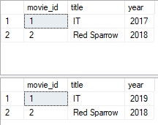
Concurrency problems - Example (Row Versioning)
In the first query window we can see the following result:
As we can see, the query executed twice in the same transaction returned two different values for the same row (unrepeatable reads)

Slide 38
Concurrency problems - Example (Row Versioning)
Phantom reads example:
We open two new query windows (two connections)
In the first query window we put the following transaction:
BEGIN TRAN;
SELECT * FROM Movies WHERE year BETWEEN 2017 AND 2020;
WAITFOR DELAY '00:00:06';
SELECT * FROM Movies WHERE year BETWEEN 2017 AND 2020;
COMMIT TRAN;

Slide 39
Concurrency problems - Example (Row Versioning)
In the second query window we put the following transaction:
BEGIN TRAN;
WAITFOR DELAY '00:00:03';
INSERT INTO Movies (title, year) VALUES ('Black Panther',2018);
COMMIT TRAN;
We start the execution of the first and the second transaction (in this order)

Slide 40
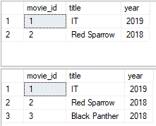
Concurrency problems - Example (Row Versioning)
In the first query window we can see the following result:
In the same transaction, a query that specified a range in its WHERE clause was executed twice and the number of rows included in the second result set is greater than the number of rows included in the first result set (phantom reads)

Slide 41
Concurrency problems - Example (Row Versioning)
Deadlock example:
We open two new query windows (two connections)
In the first query window we put the following transaction:
SET TRANSACTION ISOLATION LEVEL SNAPSHOT;
BEGIN TRAN;
UPDATE Movies SET year=2017 WHERE title='IT';
WAITFOR DELAY '00:00:05';
UPDATE Actors SET firstname= 'Alexander' WHERE lastname='Skarsgard';
COMMIT TRAN;

Slide 42
Concurrency problems - Example (Row Versioning)
In the second query window we put the following transaction:
SET TRANSACTION ISOLATION LEVEL SNAPSHOT;
BEGIN TRAN;
UPDATE Actors SET firstname= 'Alex' WHERE lastname='Skarsgard';
WAITFOR DELAY '00:00:05';
UPDATE Movies SET year=2016 WHERE title='IT';
COMMIT TRAN;
We start the execution of the first and the second transaction (in this order)

Slide 43
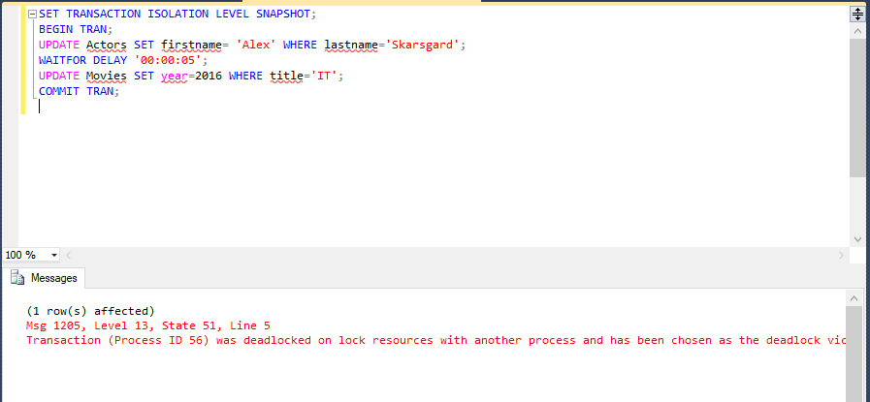
Concurrency problems - Example (Row Versioning)
A deadlock occurred, the second transaction was chosen as the deadlock victim and it was rolled back:

Slide 44
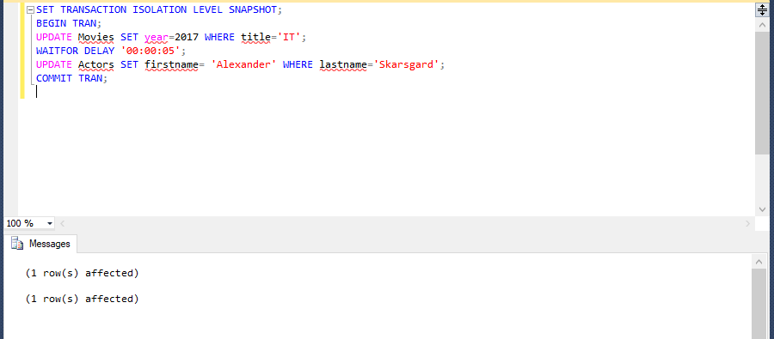
Concurrency problems - Example (Row Versioning)
Because the second transaction was chosen as the deadlock victim, the first transaction was executed successfully:

Slide 45
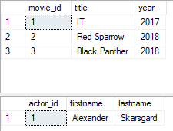
Concurrency problems - Example (Row Versioning)
If we run the following queries, we can see the final result:
SELECT * FROM Movies;
SELECT * FROM Actors;

Slide 46
Concurrency problems - Example (Row Versioning)
Update conflict example:
We open two new query windows (two connections)
In the first query window we put the following transaction:
SET TRANSACTION ISOLATION LEVEL SNAPSHOT;
BEGIN TRAN;
WAITFOR DELAY '00:00:03';
UPDATE Movies SET title='The Snowman' WHERE year=2017;
COMMIT TRAN;

Slide 47
Concurrency problems - Example (Row Versioning)
In the second query window we put the following transaction:
SET TRANSACTION ISOLATION LEVEL SNAPSHOT;
BEGIN TRAN;
UPDATE Movies SET title='Thor Ragnarok' WHERE year=2017;
WAITFOR DELAY '00:00:03';
COMMIT TRAN;
We start the execution of the first and the second transaction (in this order)

Slide 48
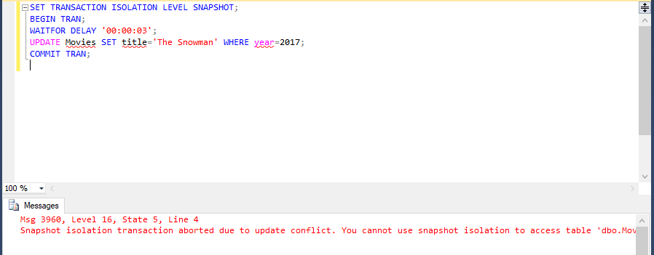
Concurrency problems - Example (Row Versioning)
An update conflict occurred and the first transaction was aborted:

Slide 49
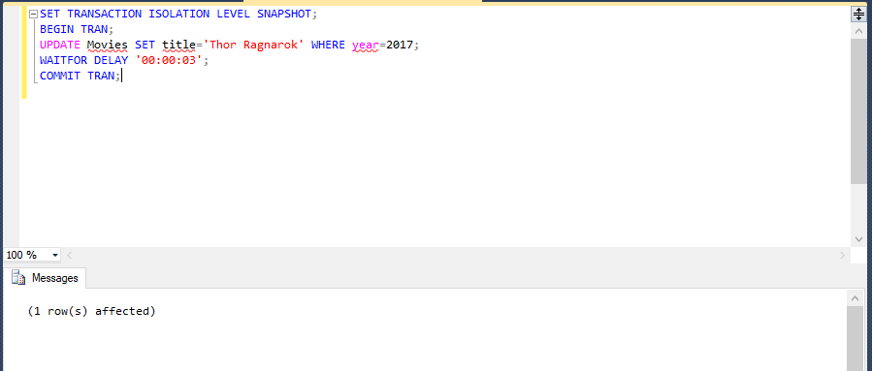
Concurrency problems - Example (Row Versioning)
Because the first transaction was aborted, the second transaction was executed successfully:

Slide 50

Concurrency problems - Example (Row Versioning)
If we run the following query, we can see the final result:
SELECT * FROM Movies;

